Slide 1
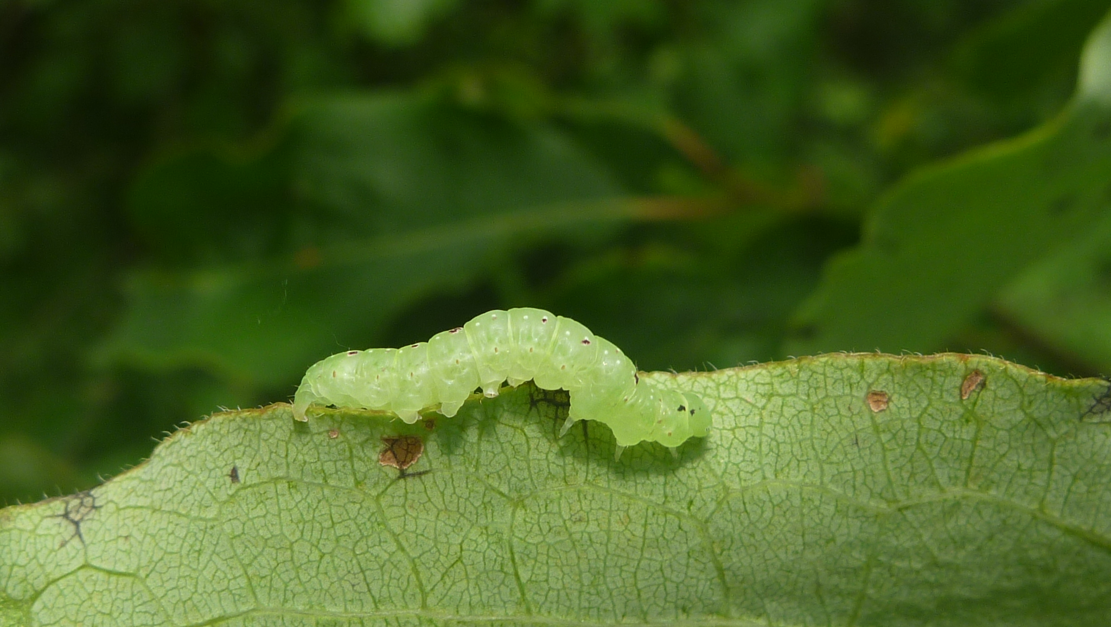
Caterpillars Count!
CITIZEN SCIENTISTS TRACKING THE PHENOLOGY OF BIRD FOOD
Allen Hurlbert
Sarah Yelton
University of North Carolina
Chapel Hill

Slide 2
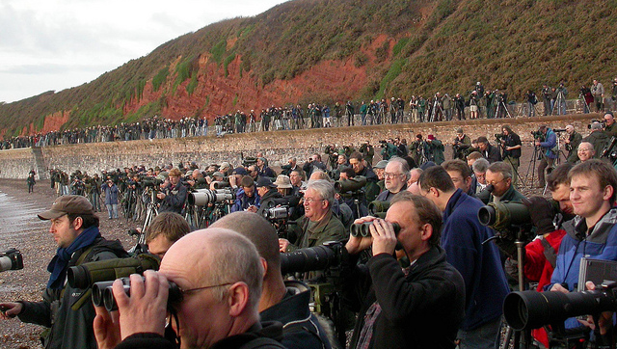

Slide 3
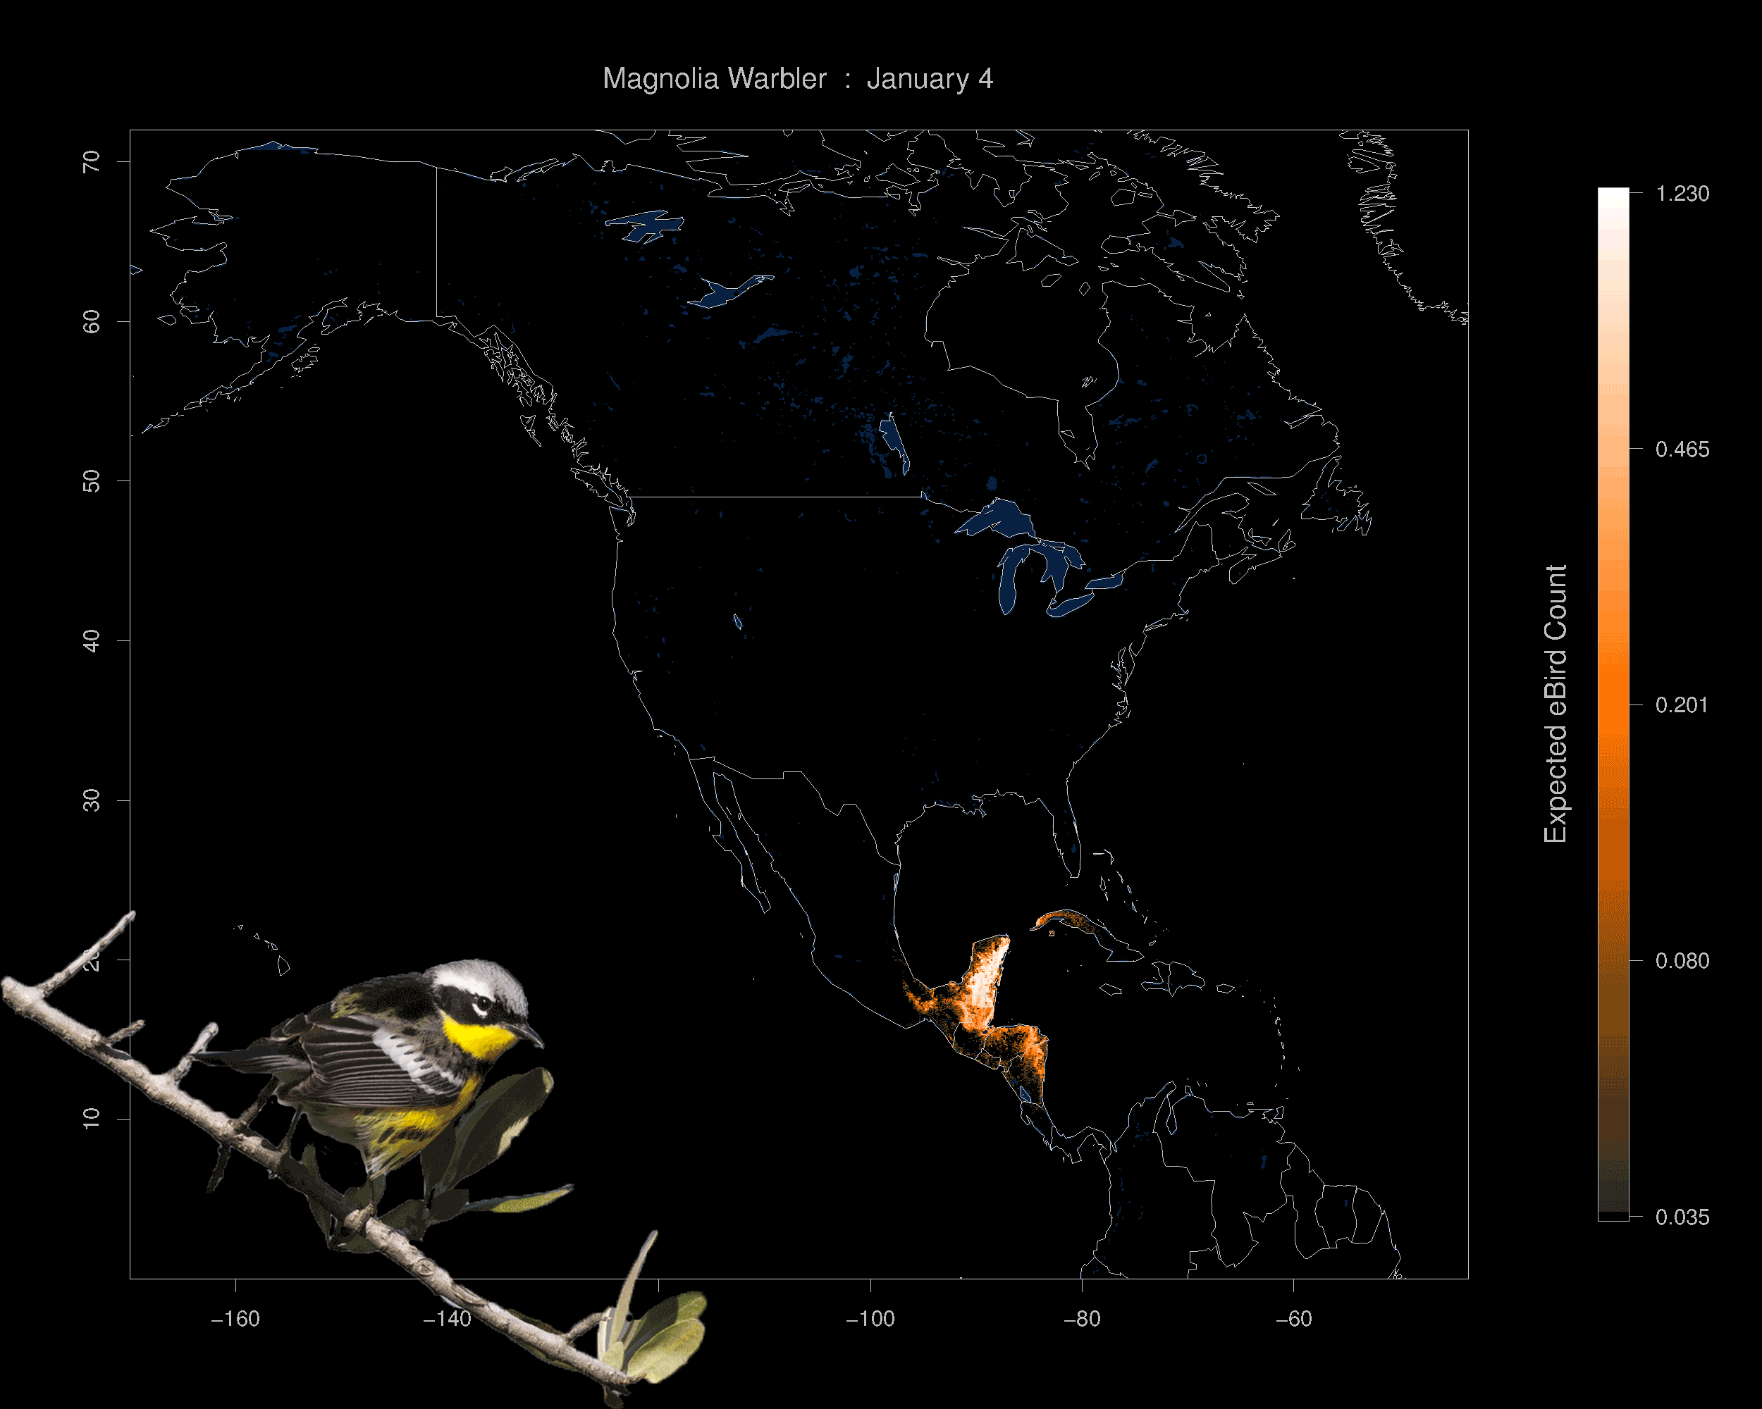

Slide 4
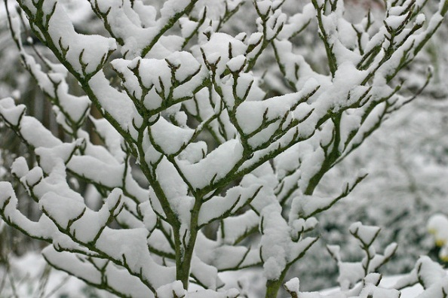
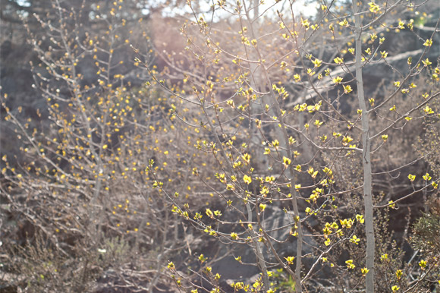
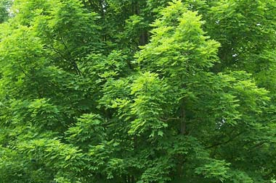
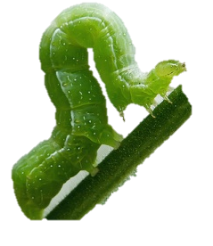
JANUARY
APRIL
JUNE
Phenology
the timing of seasonal activities in animals and plants

Slide 5
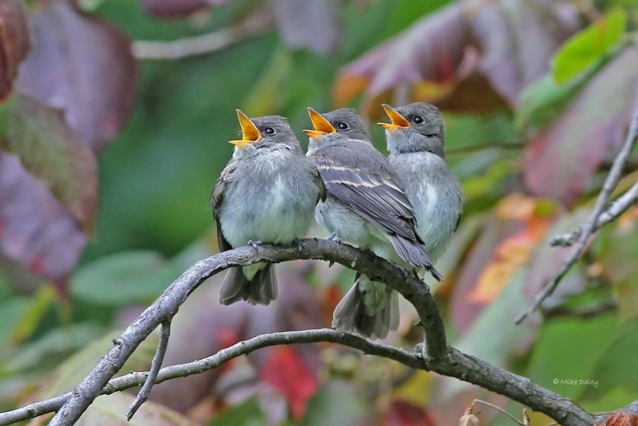
JANUARY
APRIL
JUNE

Slide 6
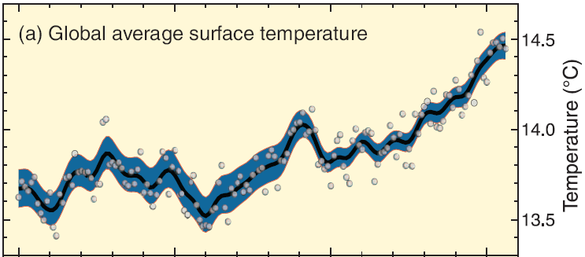
What happens to the timing of these events as temperatures rise?
JANUARY
APRIL
JUNE

Slide 7
Can birds shift the timing of their migration to adjust to changing climate?
JANUARY
APRIL
?
JUNE

Slide 8
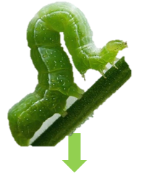
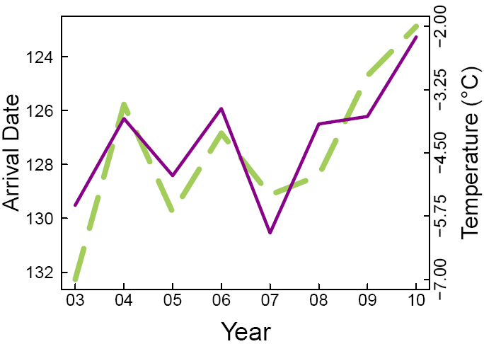
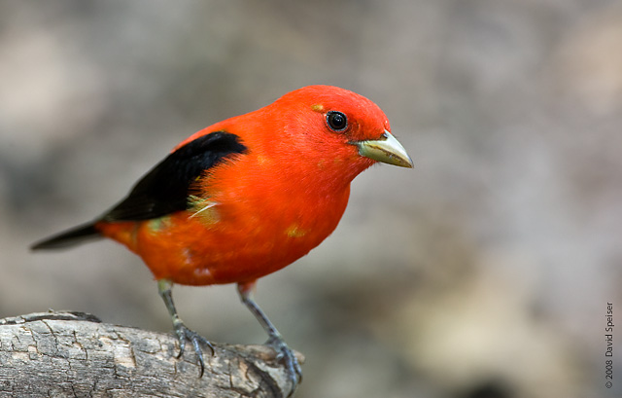
Some birds can adjust arrival dates to spring climate
JANUARY
APRIL
JUNE
May 4
6
Arrival Date
Temperature (°C)
8
10
May 12
Hurlbert & Liang 2012

Slide 9
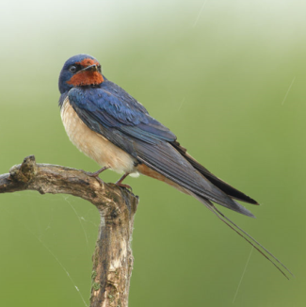
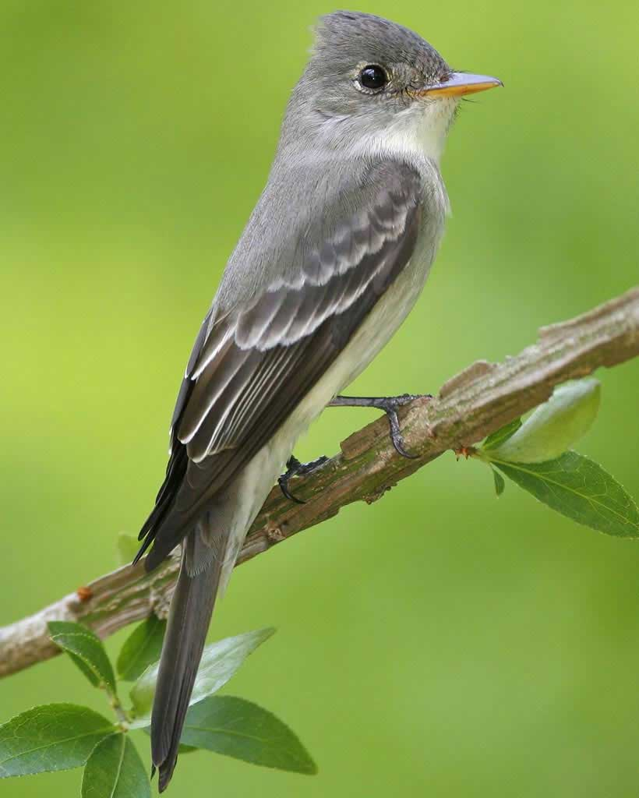
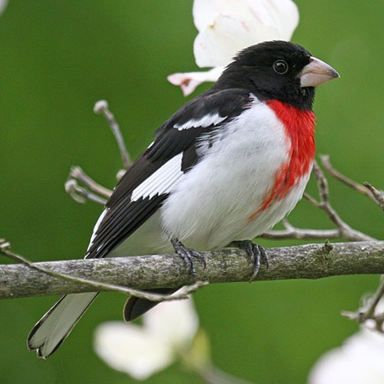
But many others are having trouble adjusting

Slide 10
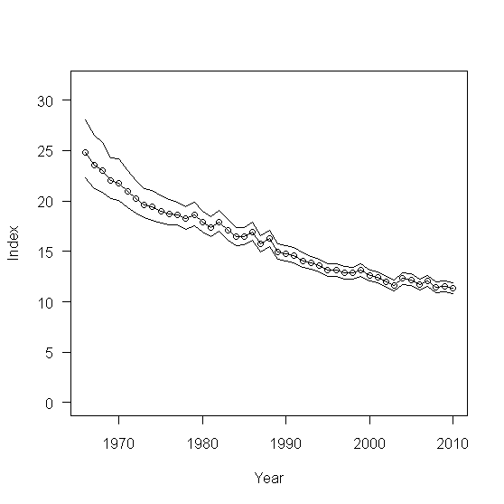
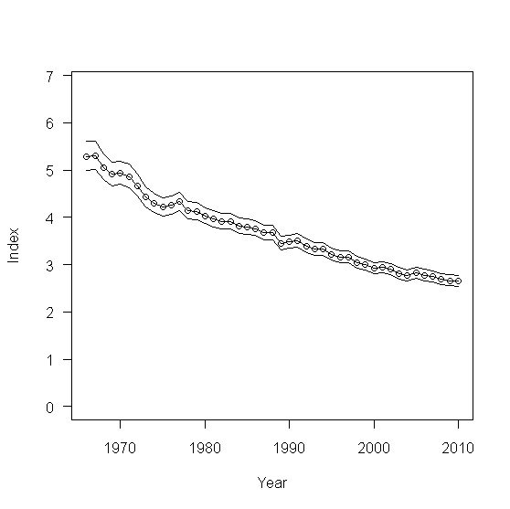
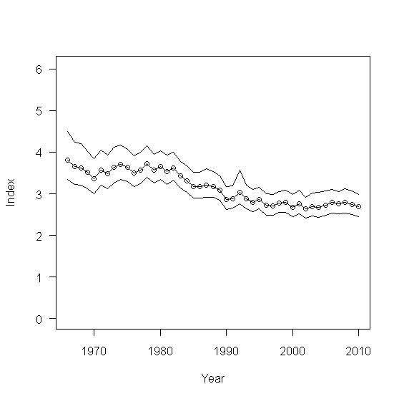
But many others are having trouble adjusting
BARN SWALLOW
EASTERN WOOD-PEWEE
ROSE-BREASTED GROSBEAK
Abundance

Slide 11
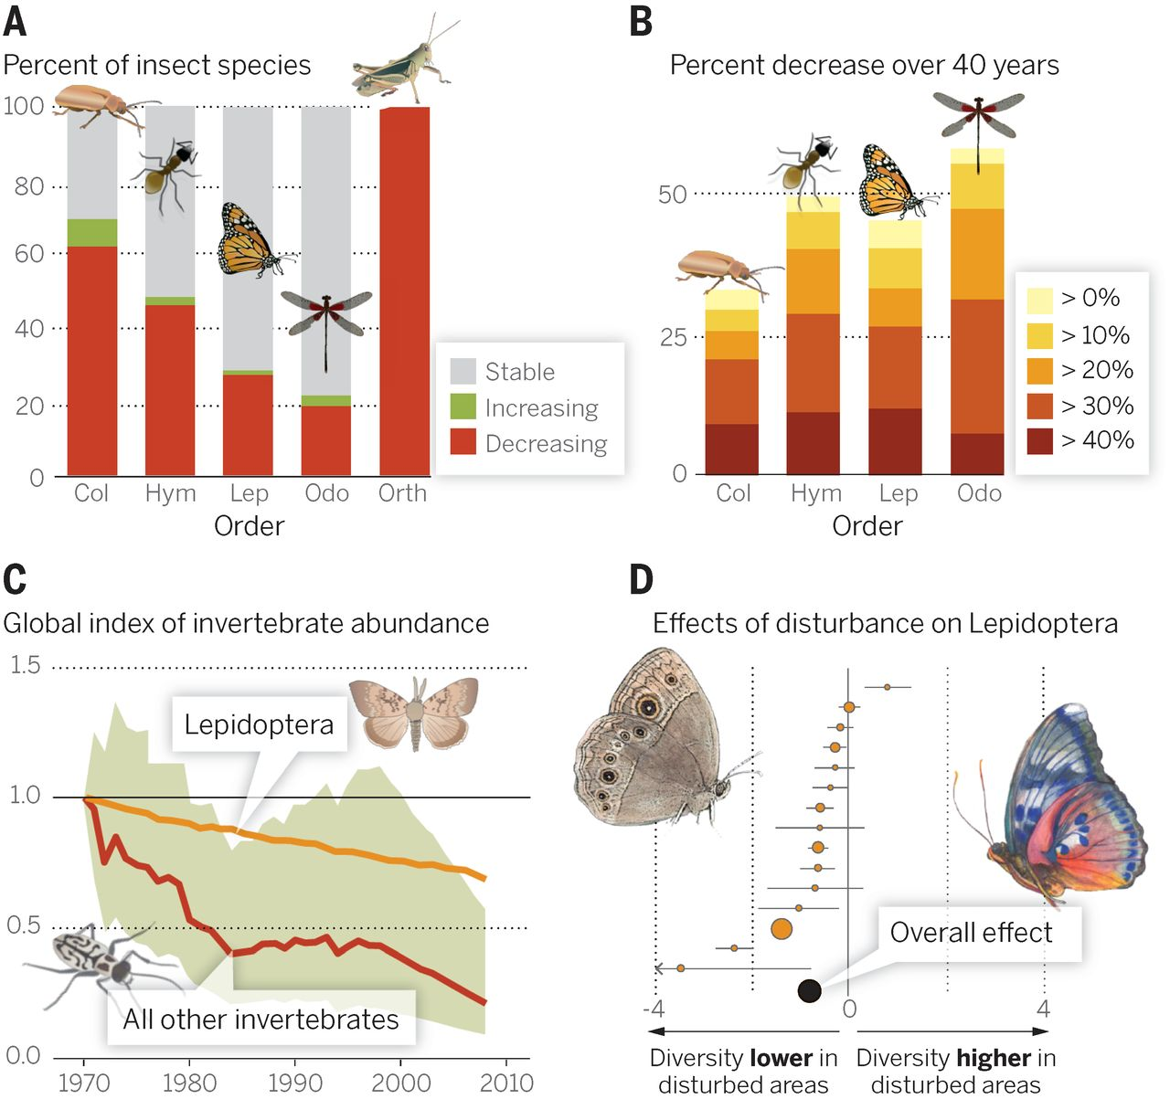
Insects are showing widespread declines globally
Dirzo et al. 2014

Slide 12
Problem
Quantifying bird food in an area, and how that varies over time
Challenge
Arthropods are patchily distributed;
Need to have high sampling effort, repeated monitoring

Slide 13
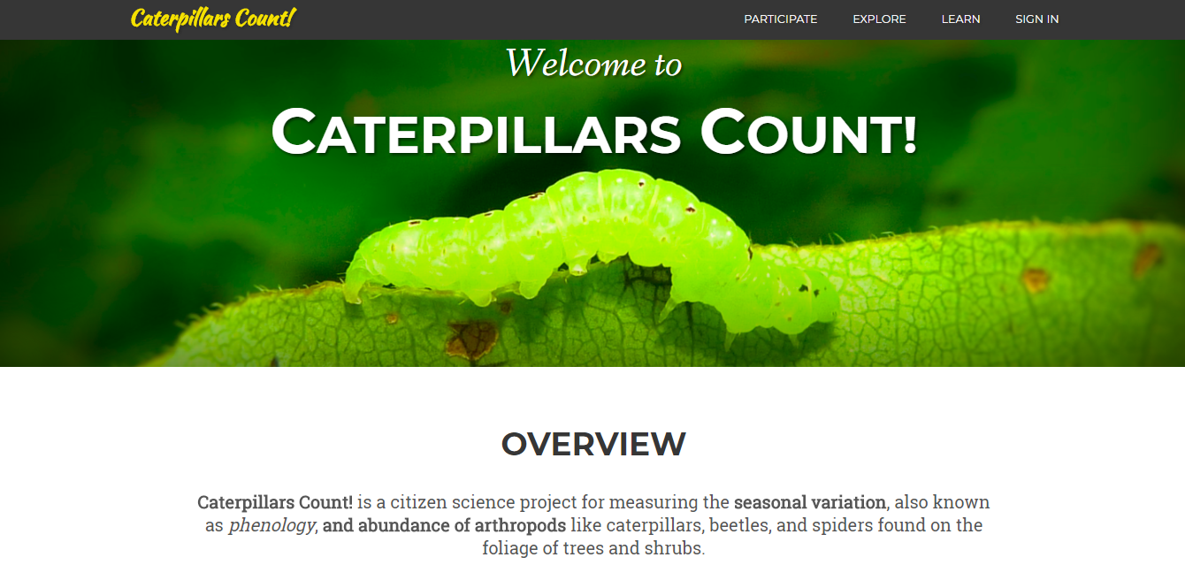

Slide 14
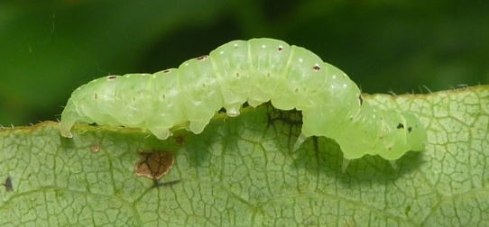
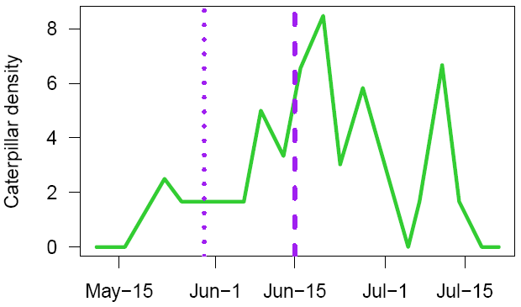
Science Goals
Collect data on the seasonal abundance of caterpillars and other foliage arthropods
on different tree species
in different habitat types
in different regions

Slide 15
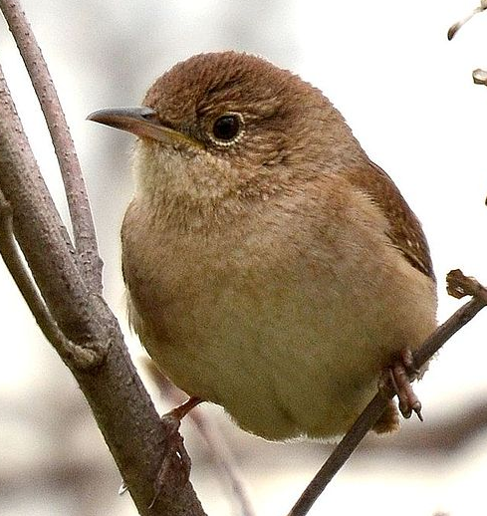
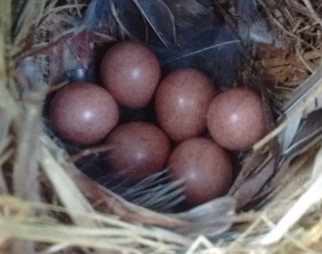
Science Goals
Relate patterns of arthropod phenology to the timing of bird migration and reproduction
hatching

Slide 16
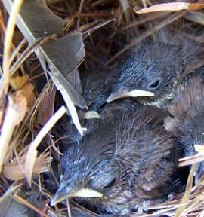
Science Goals
Relate patterns of arthropod phenology to the timing of bird migration and reproduction
hatching
fledging

Slide 17
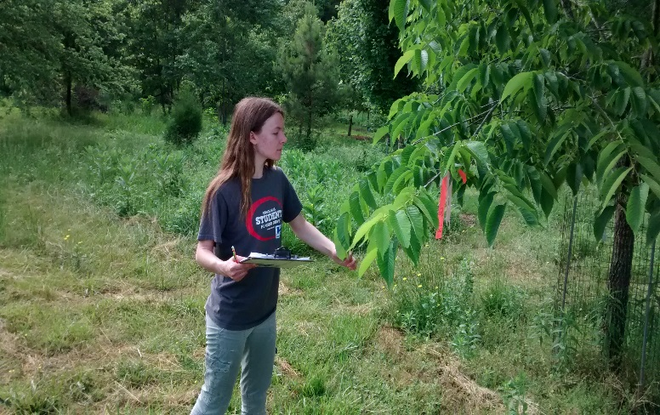
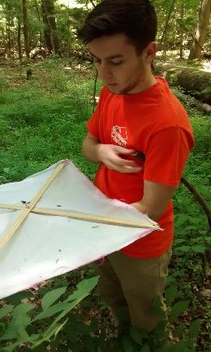
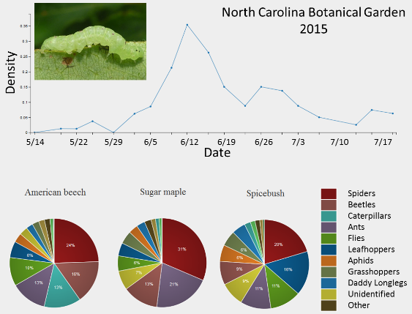
Education Goals
Learn how to identify arthropods, and explain their various roles within ecosystems
Learn about phenology, its relation to climate, and the potential impact of climate change
Gain experience interpreting maps and graphs

Slide 18
Education Goals
Learn how to identify arthropods, and explain their various roles within ecosystems
Learn about phenology, its relation to climate, and the potential impact of climate change
Gain experience interpreting maps and graphs
EDUCATORS: Incorporate lesson plans aligned to state and federal standards

Slide 19
Where will Caterpillars Count! work best?
Environmental Ed centers, Nature Centers, State Parks, year-round schools that have…
a ready source of participants throughout the growing season (late April through July) for conducting surveys every 1-2 weeks
a potential contact person who can coordinate local volunteers or participants
a natural area with suitable trees and shrubs

Slide 20
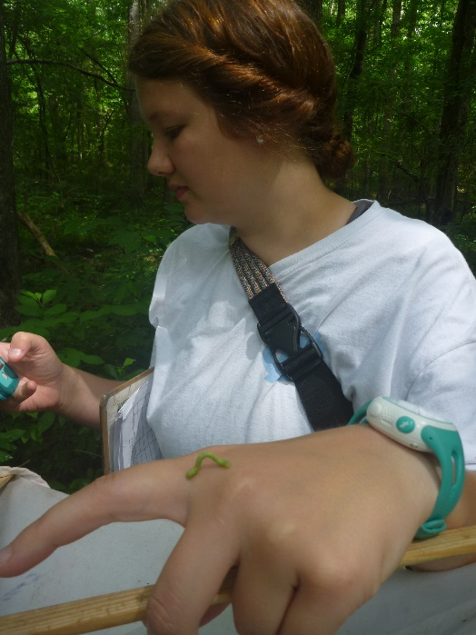
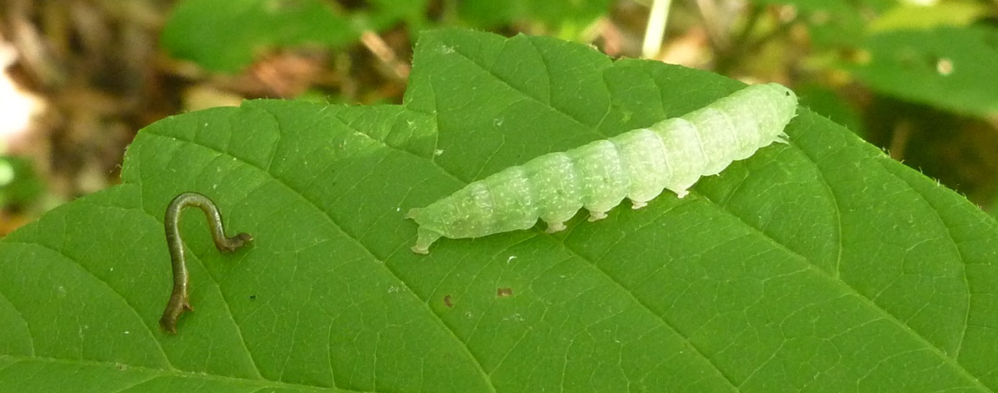
Where will Caterpillars Count! work best?
Suggested set up:
At least 30 survey trees (6 circles); allow 2.5 person-hours
Surveyed at least 6 times over late spring – summer
(preferably weekly)

Slide 21
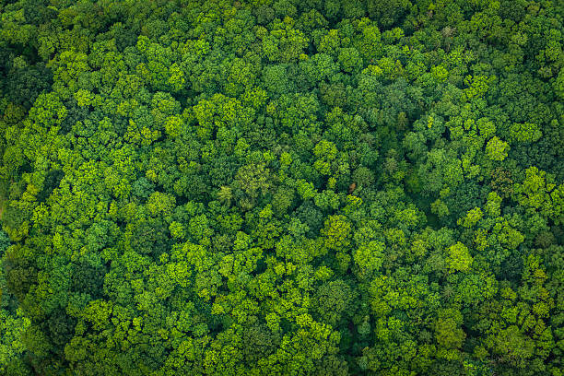
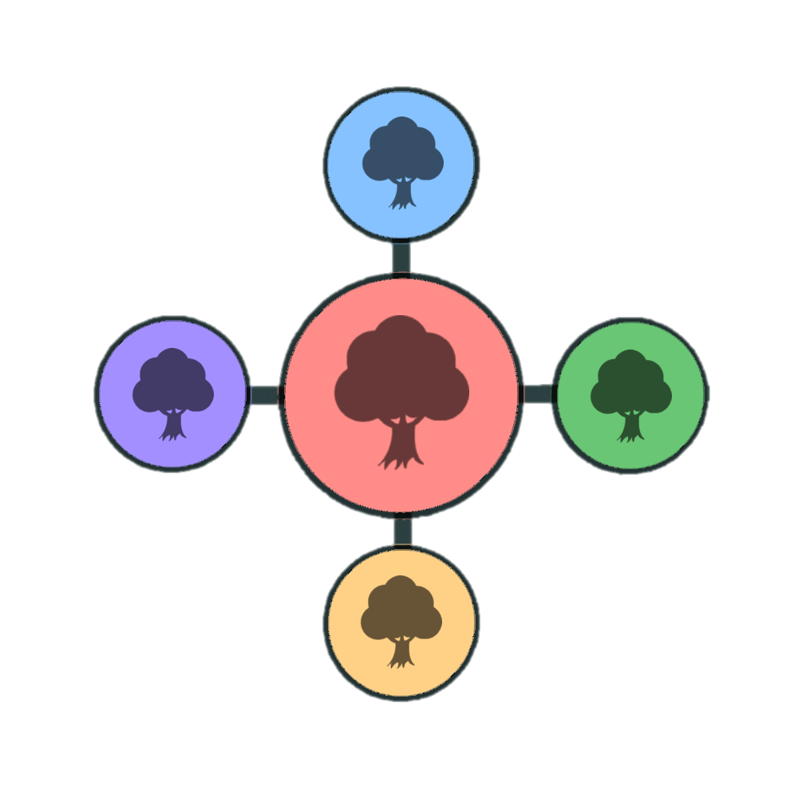

Set up Survey Site
Survey trees arranged in groups (“circles”) of 5

Slide 22
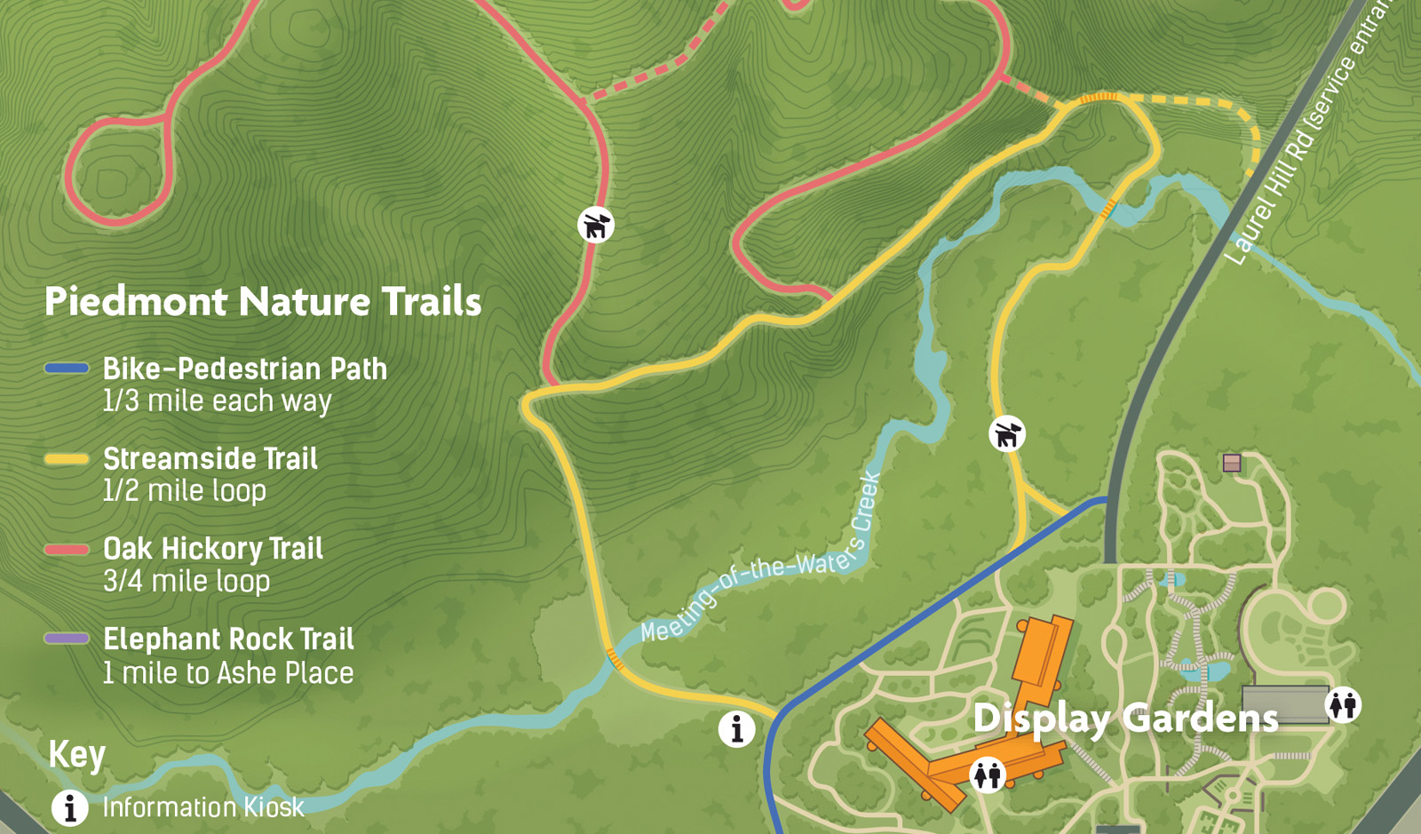
Example at NC Botanical Garden:
40 surveys in 8 groups along Streamside Trail
5 m
foliage
arthropod
survey
=
Weekly surveys from
late April - August

Slide 23
Collect and Submit Data
VISUAL SURVEYS
BEAT SHEET SURVEYS
Record data in SMARTPHONE APP or on DATASHEET for later entry via website

Slide 24
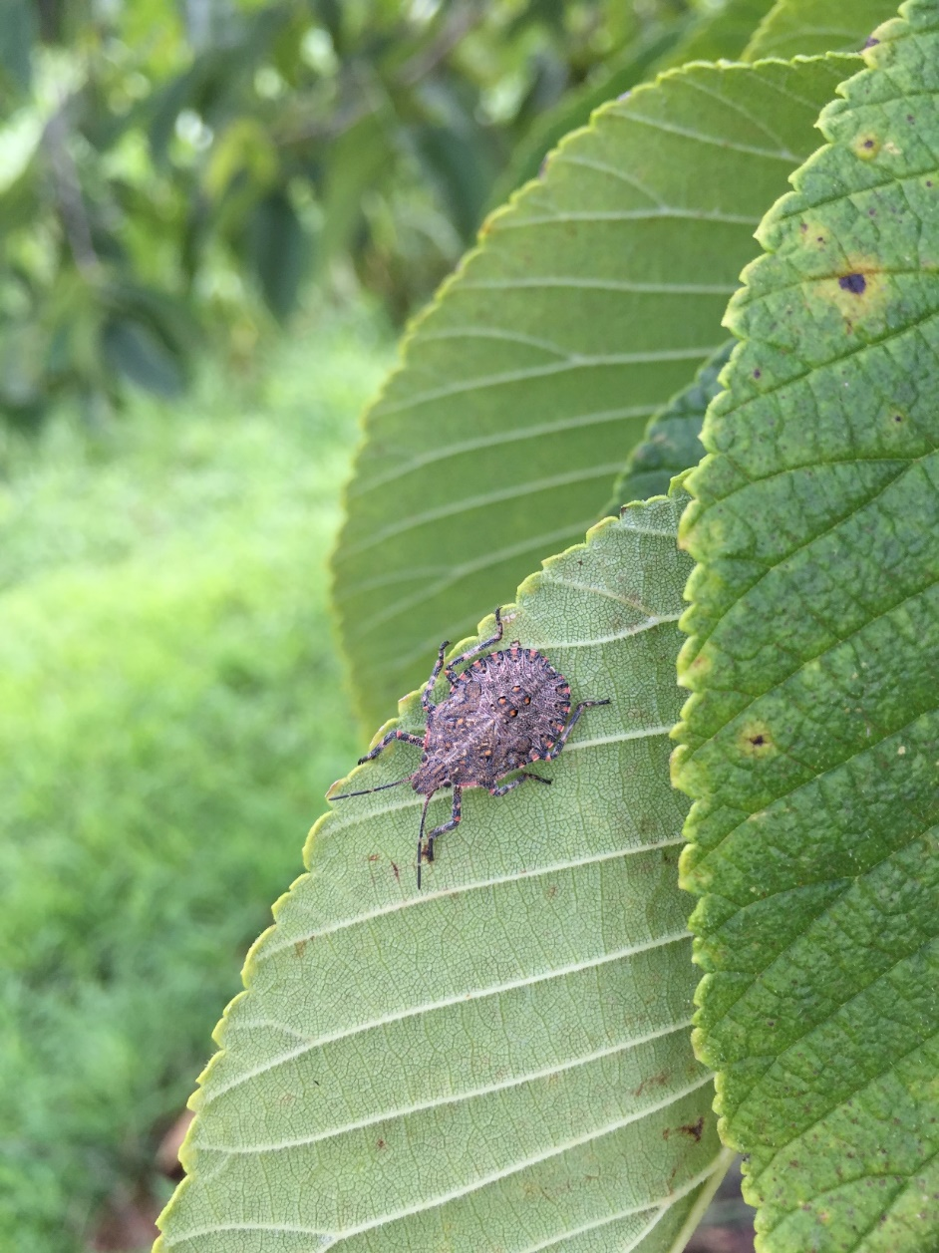
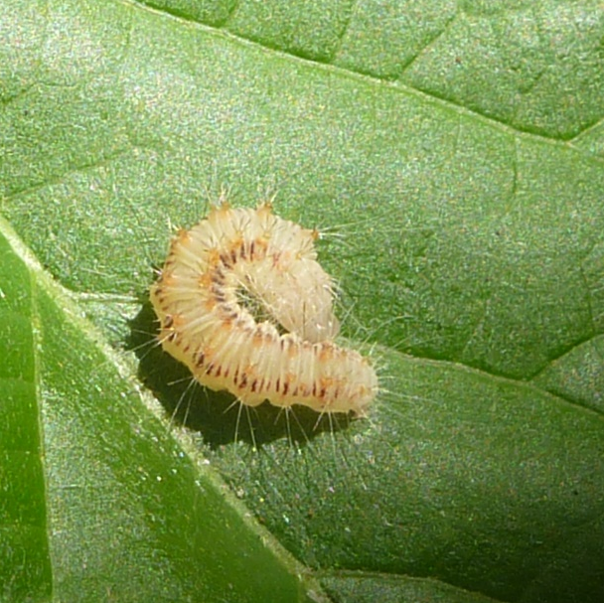
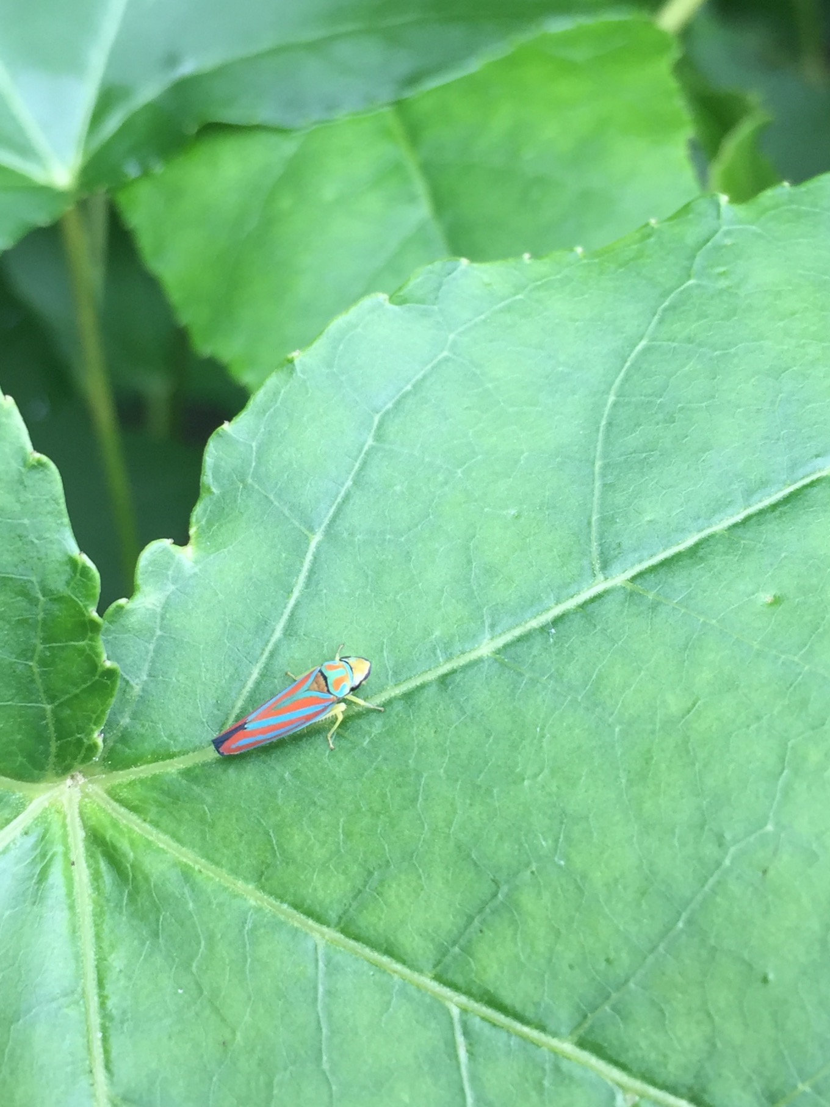
Arthropod ID
What kind of food is available to foliage gleaning birds?
Identify to ORDER
Caterpillars vs beetles vs flies vs spiders, etc.

Slide 25
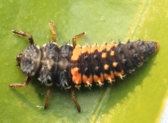
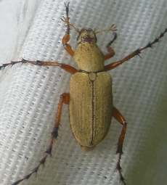
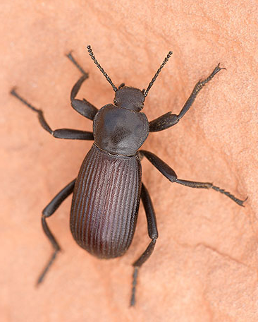
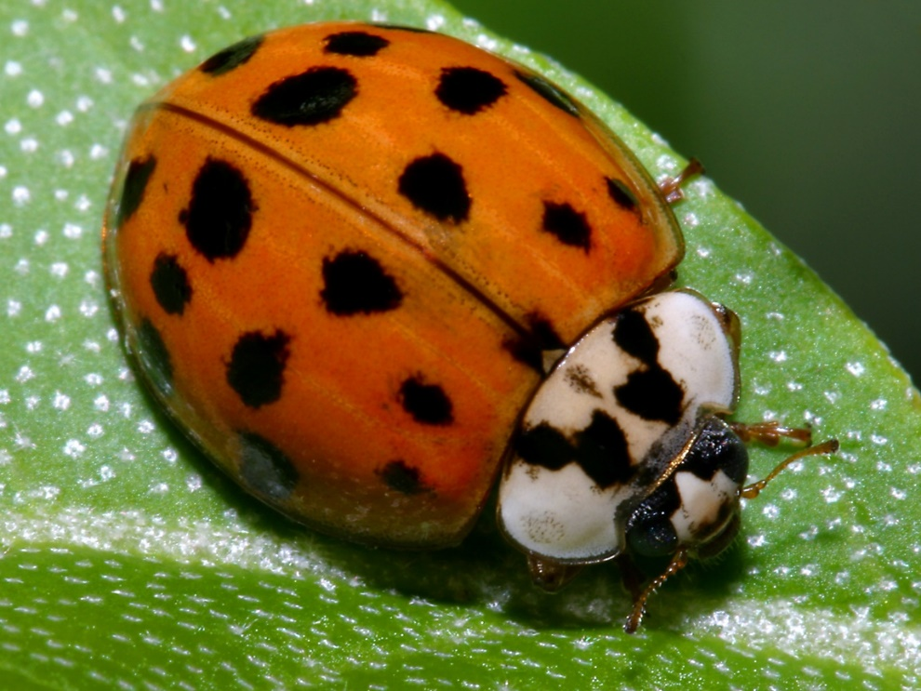
Beetles
Look for the straight line where the wing casings meet!
Ladybird beetle larva

Slide 26
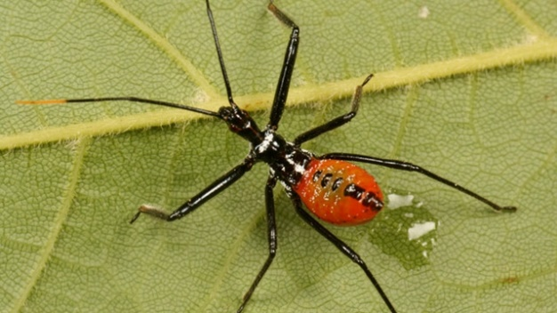
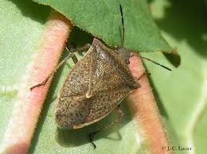
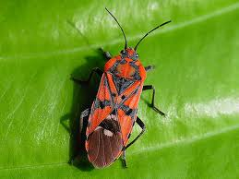
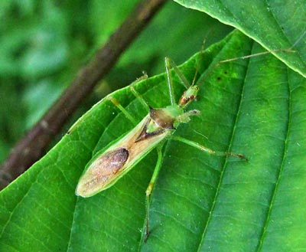
True Bugs
Look for the “X” on the back formed by overlapping wings!
And sometimes pointy “shoulders”
Nymphs don’t have wings yet, so won’t show the “X”

Slide 27
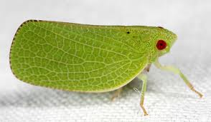
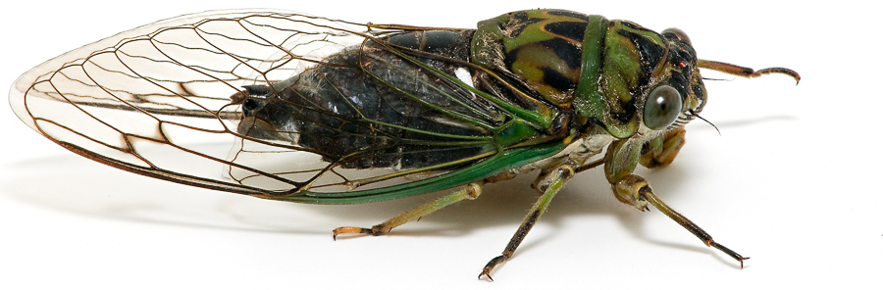
Leafhoppers, Planthoppers, Cicadas
Usually a wide head relative to body. Hoppers have wings folded tentlike over back and hop!
Cicadas have large membranous wings

Slide 28
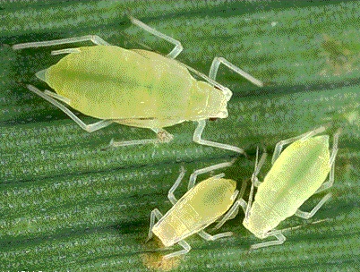
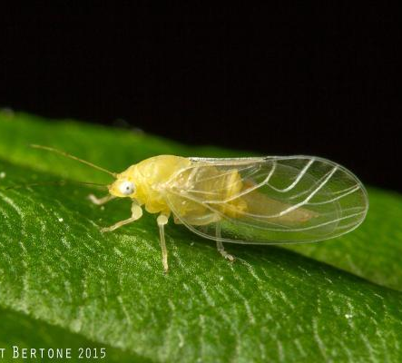
Aphids and Psyllids
Yellowish, greenish, or whitish in color.
Usually <5 mm and often <2 mm
Aphids have rounded, pointy “butts”

Slide 29
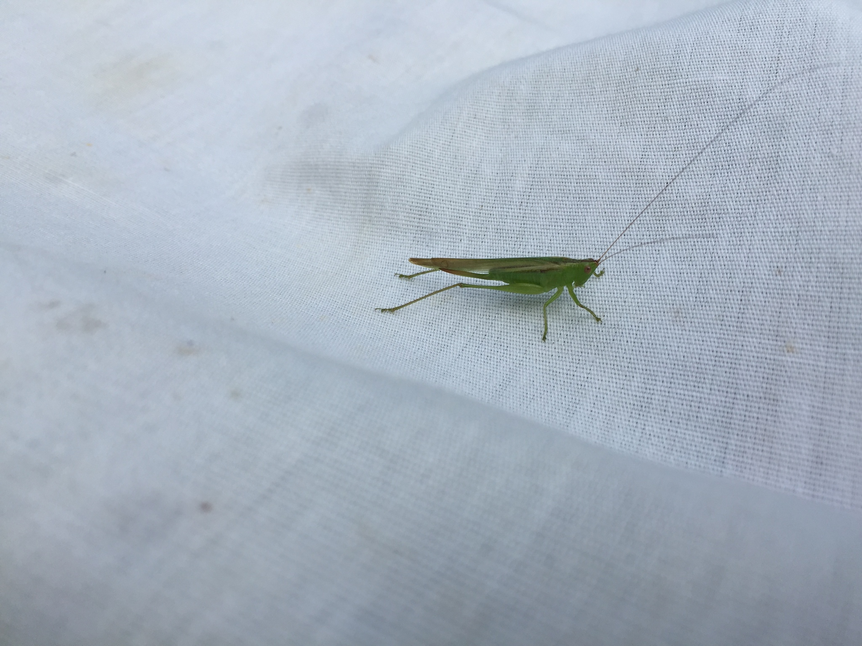
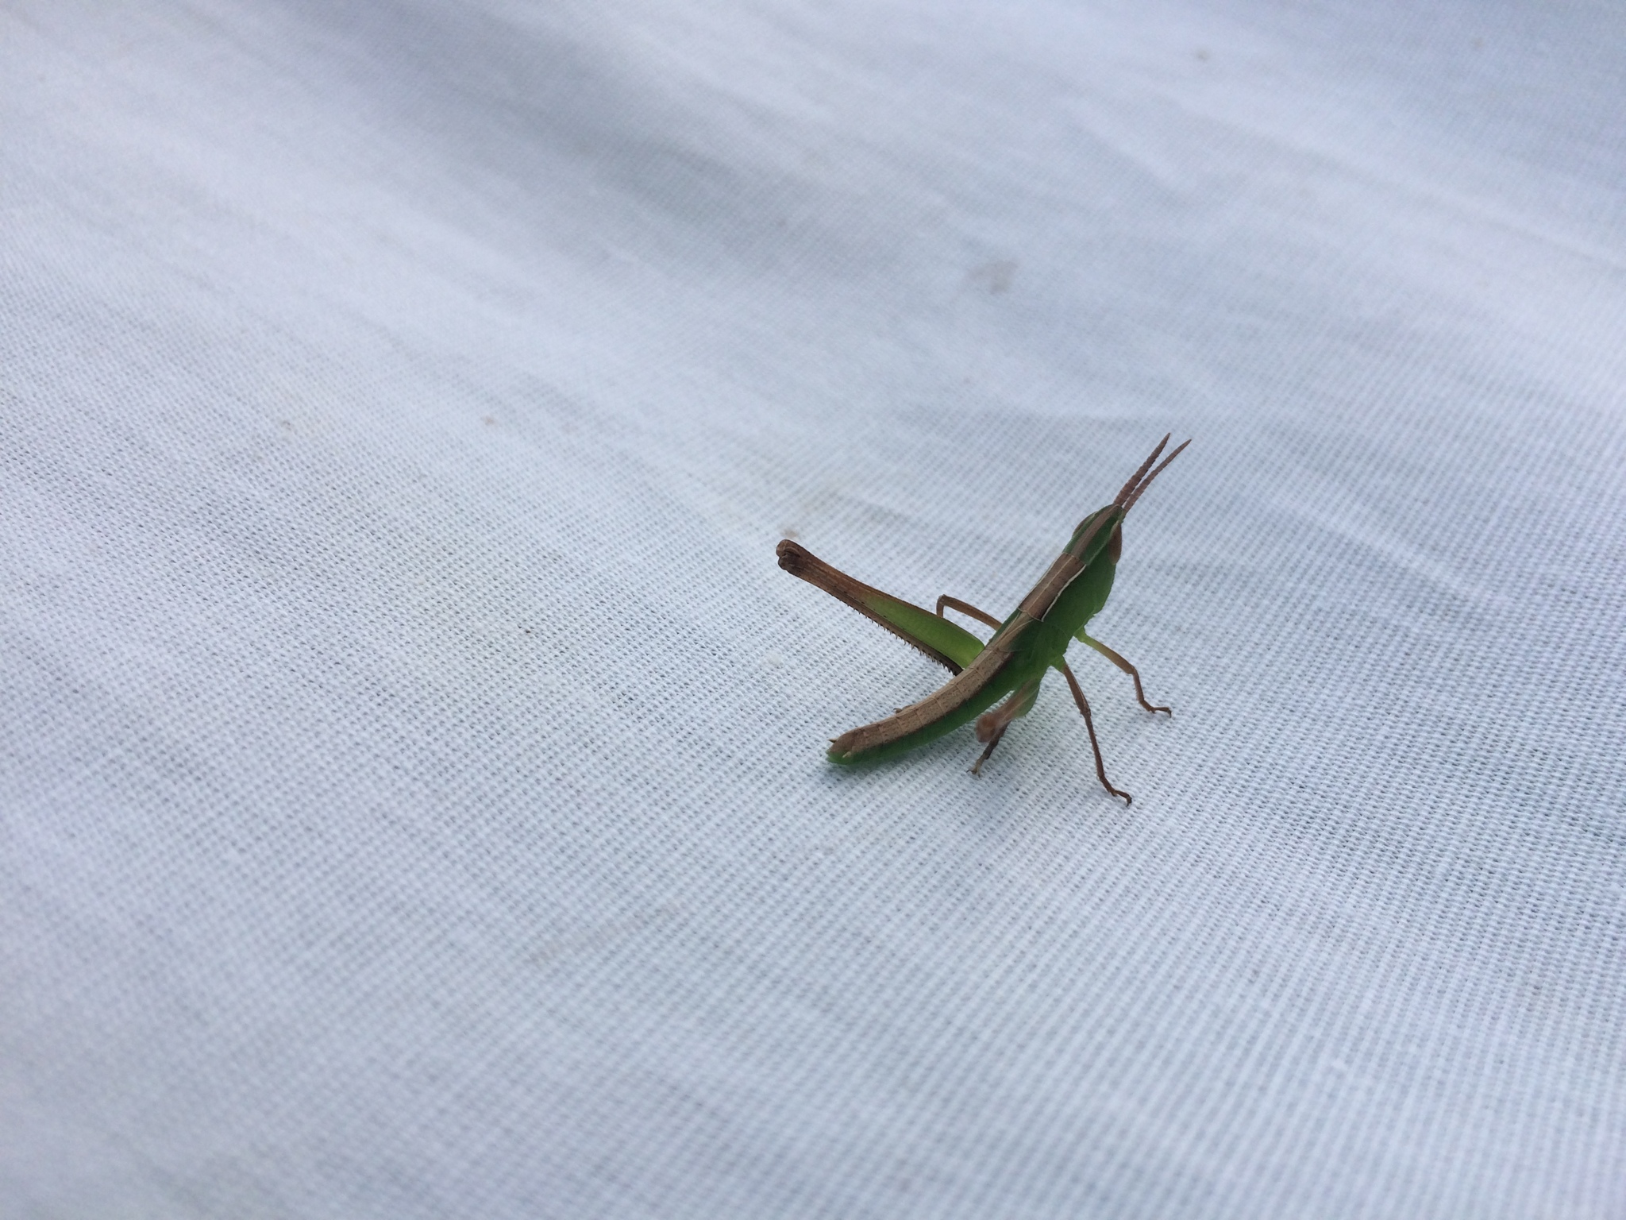


Grasshoppers, Crickets and Katydids
Large hind legs for jumping. Hind wings when open spread like fans.

Slide 30


Daddy longlegs
Spiders
Abdomen distinct from the rest of the body
vs.
Head and abdomen appear to be part of a single round “body”
Long legs!

Slide 31





Caterpillars
May be camouflaged—keep an eye out!
Also note whether it’s
in a silk tent, in
in a leaf roll,
or hairy or spiny

Slide 32
Arthropod ID
What kind of food is available to foliage gleaning birds?
Identify to ORDER
Caterpillars vs beetles vs flies vs spiders, etc.
Practice your ID skills with our online quiz!

Slide 33

Arthropod ID
caterpillarscount.unc.edu/arthropodQuiz
What kind of food is available to foliage gleaning birds?
Identify to ORDER
Caterpillars vs beetles vs flies vs spiders, etc.

Slide 34

Each branch has a unique 3-letter survey code

Slide 35




Mobile App

Slide 36
Mobile App
Share “site password” with your volunteers
App works in absence of cell/wifi – data submitted next time there’s a connection
Use the app to manage your site, change the site password, edit survey tree species names, etc.
Web-based data entry also available

Slide 37









Try using the app to conduct a survey for this test branch!
Site password: test

Slide 38



Observations you photograph could be identified by others

Slide 39
Let’s get out and try it!

Slide 40


Slide 41

Manage My Surveys
Edit survey data on the website
My Account > Manage My Surveys
Site managers can edit surveys submitted by any user at their site

Slide 42

Explore the Data

Slide 43


Slide 44

Visualize phenology of different arthropod groups for any site or year

Slide 45
Visualize the composition of different arthropod groups…
NCBG

Slide 46
…and how arthropod composition varies by tree species, site or year

Slide 47


Slide 48
What have we found so far?

Slide 49

Different sampling methods yield different perceptions of the relative abundance of arthropod groups
Other
Grasshoppers, Crickets
Caterpillars
VISUAL SURVEY
BEAT SHEET SURVEY
Flies
Beetles
Leaf hoppers, cicadas
Spiders

Slide 50

The timing of the seasonal peak

Slide 51

The timing of the seasonal peak varies with latitude
37 days
Caterpillar density
Jun-1 Jul-1 Aug-1
6 days
Jun-1 Jul-1 Aug-1

Slide 52
The timing of the seasonal peak varies with latitude but also within regions
37 days
Jun-1 Jul-1 Aug-1
6 days
Jun-1 Jul-1 Aug-1

Slide 53



How are birds timing migration and breeding relative to the seasonality of their food sources?
hatching
fledging
2016 | Prairie Ridge Ecostation, Raleigh, NC

Slide 54

Join Us!
Sign up at caterpillarscount.unc.edu
Questions?
Email caterpillarscount@gmail.com
Dr. Allen Hurlbert, Project Leader
Funded by the National Science Foundation

